Slide 1
L-System Dungeon Generation
By: Nick Shaffer

Slide 2
Goals
To create a procedurally generated dungeon using L-Systems
The dungeon should span horizontally as well as vertically
My iteration rules needed to form a dungeon that was both interesting and sufficiently complex
There could be no overlapping paths

Slide 3
Iteration Rules
Axiom: SXE
X | F | S | E
→ F → FF → F[>F]F → F[<F]F → *U*F → *D*F | → FX → >FX → <FX → [>F]F → [<F]F | → <S → <<S → <<<S → S | → <E → <<E → <<<E → E

Slide 4
Drawing Rules
X = 0 = Terminating character
F = 1 = Straight line
< = 2 = 90-degree rotation counterclockwise
> = 3 = 90-degree rotation clockwise
[ = 4 = Start a branch
] = 5 = End a branch
U = 6 = Angle up
D = 7 = Angle down
S = 8 = Start
E = 9 = End
* = 10 = Straight line

Slide 5
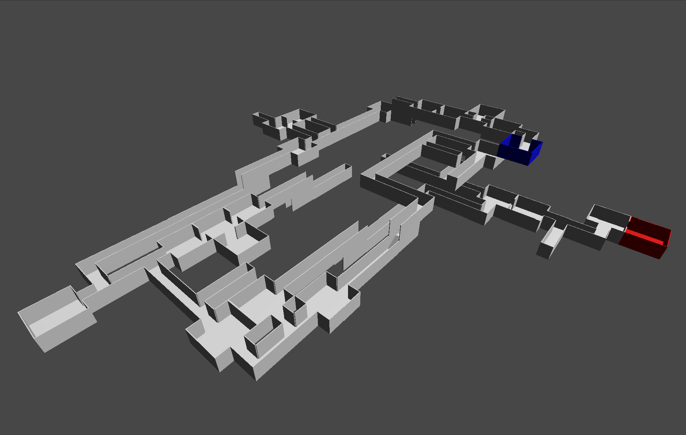
Examples
2.2.2.8.2.3.2.1.0.1.4.3.1.5.1.10.7.10.2.1.0.2.3.1.0.1.4.3.1.5.1.4.3.2.3.1.0.1.4.3.1.5.1.5.3.2.1.0.10.7.10.1.1.0.1.1.2.1.0.4.3.1.0.5.2.1.0.4.2.3.2.3.1.0.1.4.3.1.5.1.10.7.10.1.0.5.3.1.0.1.4.2.1.5.1.1.0.2.1.0.4.2.3.3.2.1.0.1.10.6.10.2.1.0.1.0.3.1.0.2.3.1.0.1.4.3.1.5.1.3.1.0.4.3.2.1.0.0.3.1.0.1.0.5.3.0.0.0.5.3.2.2.1.0.0.3.1.0.10.7.10.2.3.1.0.1.1.3.1.0.1.2.1.0.4.2.1.0.1.4.3.1.5.1.1.0.5.3.1.0.1.4.3.1.5.1.2.1.0.2.2.2.9

Slide 6
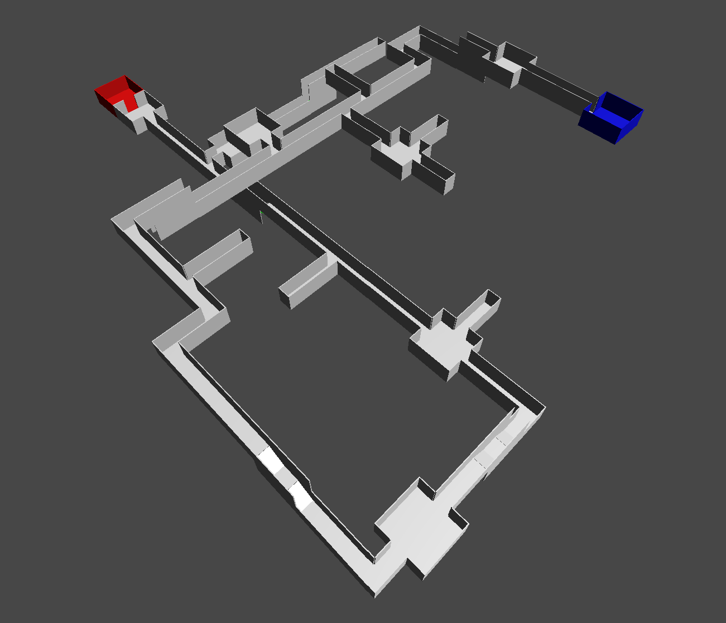
Examples
2.2.2.2.8.3.2.1.0.10.7.10.1.2.1.0.2.1.0.3.1.0.1.4.3.1.5.1.4.2.1.0.1.4.2.1.5.1.5.3.2.1.0.1.4.3.1.5.1.10.6.10.2.1.0.1.4.2.1.5.1.3.1.0.3.2.2.1.0.10.7.10.1.2.1.0.10.7.10.2.1.0.1.4.3.1.5.1.3.2.1.0.1.4.2.1.5.1.10.7.10.1.0.4.2.3.3.1.0.1.10.6.10.1.0.5.3.2.1.0.1.1.0.2.2.2.2.9

Slide 7
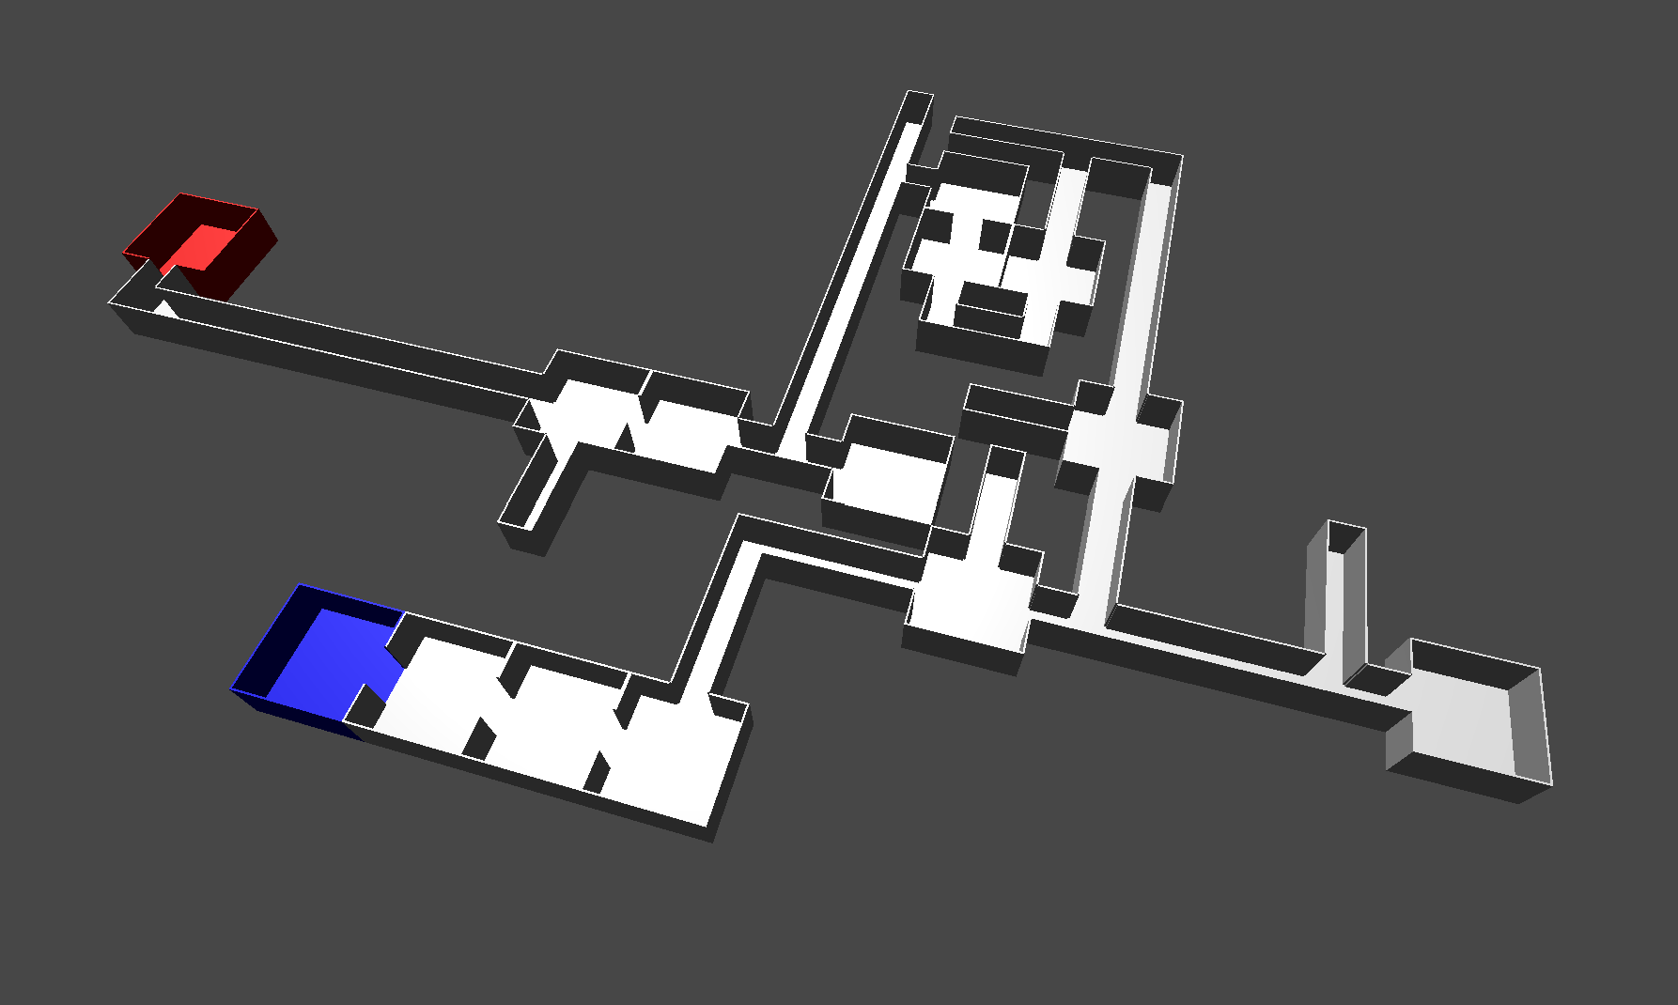
Examples
2.2.2.2.2.8.3.2.3.2.1.0.1.2.1.0.1.0.3.1.0.1.4.2.1.5.1.4.2.3.1.0.1.4.2.1.5.1.5.2.1.0.1.4.2.1.5.1.3.2.1.0.1.1.2.1.0.4.3.2.1.0.5.2.1.0.1.0.1.3.1.0.3.1.0.2.3.3.2.1.0.0.2.1.0.4.3.1.0.5.2.1.0.2.3.1.0.1.1.4.2.1.0.0.5.3.1.0.1.4.2.1.5.1.2.3.1.0.1.1.0.1.0.2.2.2.2.2.2.2.9

Slide 8
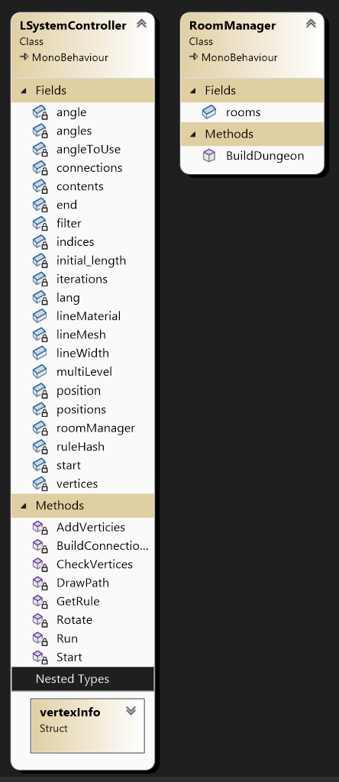
Design
Started with provided L-System code as a base
Starting axiom is iterated upon until a final string is produced that will represent the dungeon
Drawing rules will decide how each character in the string is translated into vertex information
Checking for overlaps occurs as drawing rules are applied
When all vertices have been added to the path, a list of connections is created to help determine what the room at that vertex will look like

Slide 9
Implementation: Selecting Rules
A single byte is pulled from the current L-System string
If this byte has iteration rules, select one at random and try to apply it to the current dungeon path
If the resulting vertices can be added without creating overlaps or invalid room placements, they are added to the path
If a valid rule cannot be found, substitute byte with terminating character and move on to the next byte
This is also where I make sure an exit can spawn

Slide 10
Implementation: Adding Vertices
Keep track of current status of path
Position
Angle
Branch status
Create a temporary state for these values using the current state
For every potential iteration rule, apply drawing rules to create a list of potential vertices
Check validity of these vertices with current dungeon path
If valid, apply temporary state and add vertices to path
Otherwise, change nothing, no vertices could be added

Slide 11
Implementation: Check for Valid Vertices
Check for colliding endpoints
Check for straight branching paths coming out of the same vertex as an up/down path
Check for crossing diagonals
Prevent from moving up/down if there is an existing vertex above/below current
Note: Not technically an overlap, but it makes the geometry look strange
Prevent from moving across if there is an existing vertex above/below that just moved or is about to move up/down
Note: Not technically an overlap, but it makes the geometry look strange

Slide 12
Clever Implementation
Generation and display of dungeon rooms
Create dictionary of unique vertices and their connected vertices
Use number, direction, and type of each connection from each vertex to create a unique room string
First part: String of four bytes, either 0 or 1, represent connections forward, right, back, left (e.g., 0110 = no forward, right, back, no right)
Second part: Type of room, either start, end, or upward/downward path moving forward, left, back, or right
Final part: Further elaborates on the room type, being either a hallway or more of a room

Slide 13
Clever Implementation
62 prefabs for each potential room string
Once room string complete, loop through all available rooms to find the correct room for the current vertex
Perhaps not the most optimal solution, but
Relatively intuitive for me,
No need to worry about rotating rooms to find the correct orientation for the number of connections coming from a given vertex,
Prefabs easy to make

Slide 14
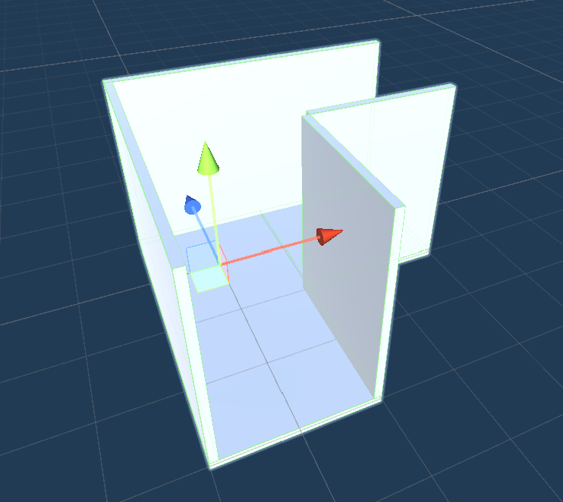
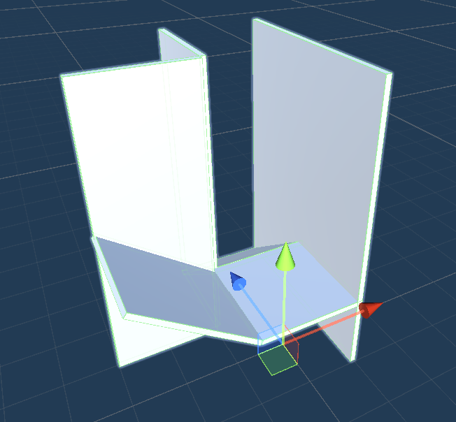
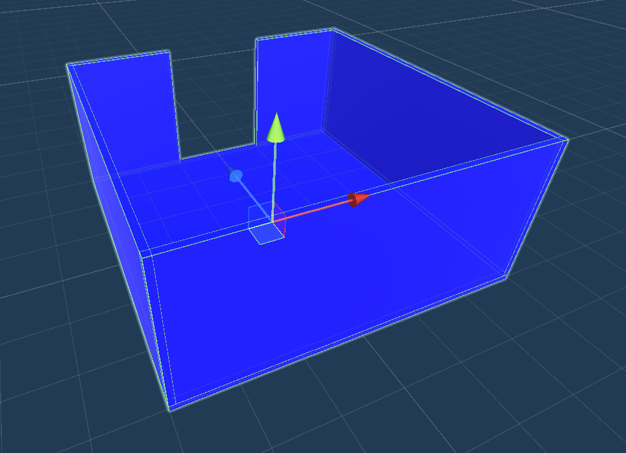
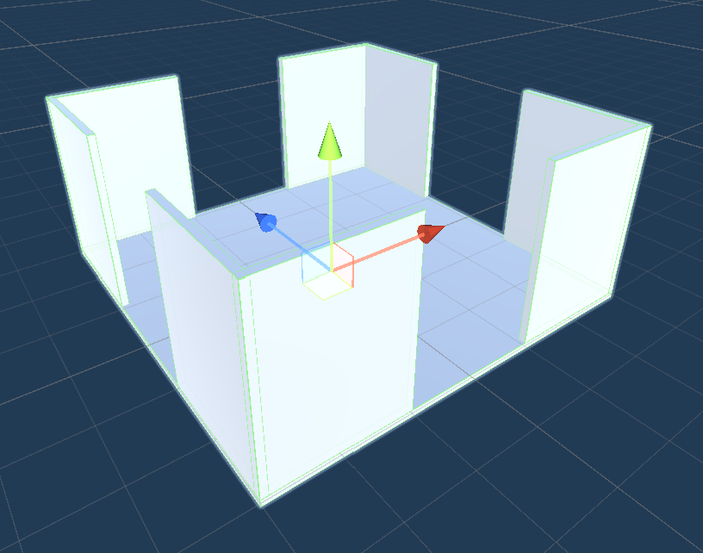
Clever Implementation
Examples:
0110 (1)
A hallway style room with connections to the right and back
1001 DownRight
A downward path moving from the right towards the forward direction
1000 Start
A starting room that exits in the forward direction
1111 (2)
A “room” style room with connections in all directions

Slide 15
Difficulties
Overlap detection
Needed to find a way to temporarily implement drawing rules so I could determine if they would result in any overlaps or invalid room placements
Started by trying to handle overlaps in just the x-z plane
Once figured out, moved on to adding paths that moved up and down
One particularly annoying edge case required 16 additional room prefabs for relatively rare bug

Slide 16
Reflection
Relatively proud of where project ended up, not sure how much I’d change in terms of implementation
Wasn’t entirely happy with iteration rules
Ideally, more iterations = larger dungeons
Relatively inconsistent as is
Long, straight paths boring
Occasionally uncharacteristically small and simple
With more time,
Nicer rooms, either from asset store or modeled myself
Gameplay elements?
AI NPC that finds their way through dungeon, with the dungeon rebuilding in a new configuration every time they reach the end

